Slide 1
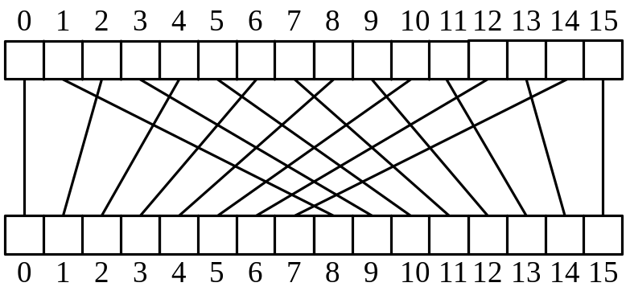
The Fast Fourier Transform
FFT
Notes:
Cryptography
11/08/26 11/08/26

Slide 2

Outline and Reading
Polynomial Multiplication Problem
Primitive Roots of Unity
The Discrete Fourier Transform
The FFT Algorithm
Integer Multiplication
Java FFT Integer Multiplication
FFT

Slide 3

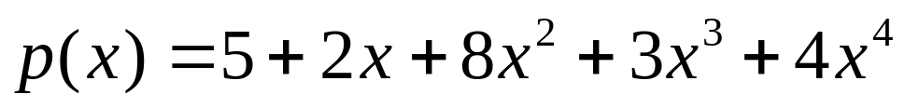
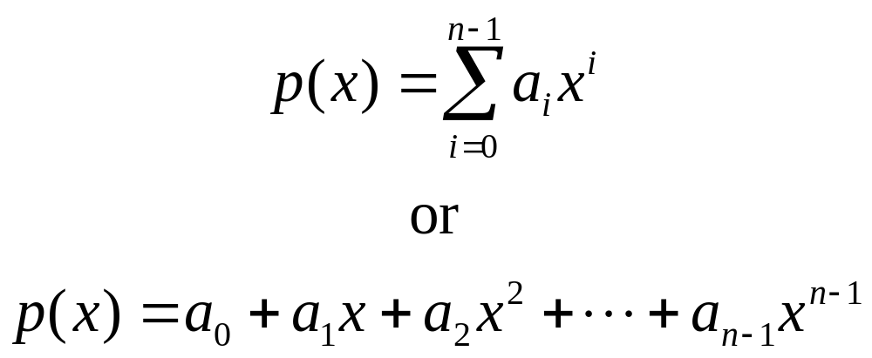
Polynomials
Polynomial:
In general,
FFT

Slide 4

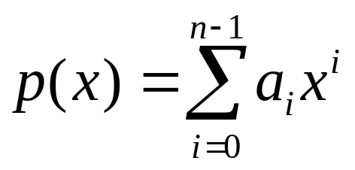
Polynomial Evaluation
Horner’s Rule:
  Given coefficients (a₀,a₁,a₂,…,a_{n-1}), defining polynomial
  Given x, we can evaluate p(x) in O(n) time using the equation
Eval(A,x): [Where A=(a₀,a₁,a₂,…,a_{n-1})]
  If n=1, then return a₀
  Else,
    Let A’=(a₁,a₂,…,a_{n-1}) [assume this can be done in constant time]
    return a₀+x*Eval(A’,x)
FFT

Slide 5
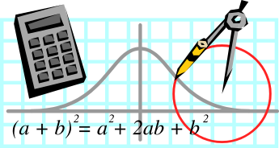
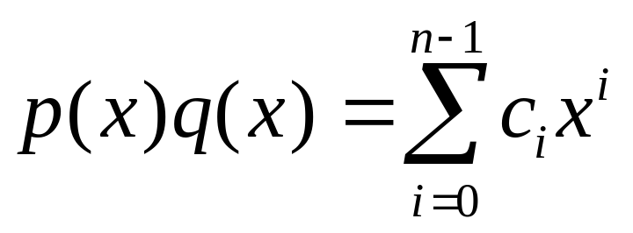
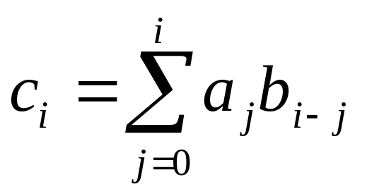
Polynomial Multiplication Problem
Given coefficients (a₀,a₁,a₂,…,a_{n-1}) and (b₀,b₁,b₂,…,b_{n-1}) defining two polynomials, p() and q(), and number x, compute p(x)q(x).
Horner’s rule doesn’t help, since
  where
A straightforward evaluation would take O(n²) time. The “magical” FFT will do it in O(n log n) time.
FFT

Slide 6
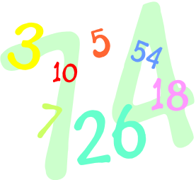
Polynomial Interpolation & Polynomial Multiplication
Given a set of n points in the plane with distinct x-coordinates, there is exactly one (n-1)-degree polynomial going through all these points.
Alternate approach to computing p(x)q(x):
  Calculate p() on 2n x-values, x₀,x₁,…,x_{2n-1}.
  Calculate q() on the same 2n x values.
  Find the (2n-1)-degree polynomial that goes through the points {(x₀,p(x₀)q(x₀)), (x₁,p(x₁)q(x₁)), …, (x_{2n-1},p(x_{2n-1})q(x_{2n-1}))}.
Unfortunately, a straightforward evaluation would still take O(n²) time, as we would need to apply an O(n)-time Horner’s Rule evaluation to 2n different points.
The “magical” FFT will do it in O(n log n) time, by picking 2n points that are easy to evaluate…
FFT

Slide 7
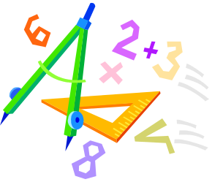
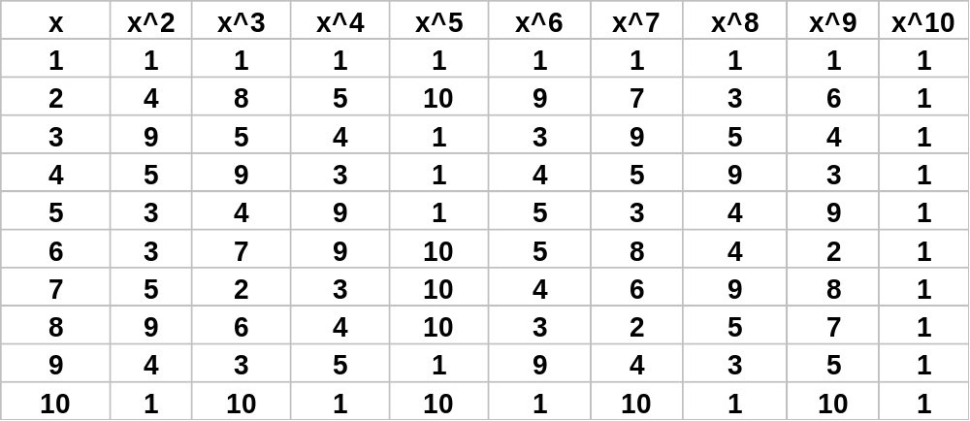

Primitive Roots of Unity
A number ω is a primitive n-th root of unity, for n>1, if
  ω^{n} = 1
  The numbers 1, ω, ω², …, ω^{n-1} are all distinct
Example 1:
  Z*₁₁:
  2, 6, 7, 8 are 10-th roots of unity in Z*₁₁
  2²=4, 6²=3, 7²=5, 8²=9 are 5-th roots of unity in Z*₁₁
  2⁻¹=6, 3⁻¹=4, 4⁻¹=3, 5⁻¹=9, 6⁻¹=2, 7⁻¹=8, 8⁻¹=7, 9⁻¹=5
Example 2: The complex number e^{2πi/n} is a primitive n-th root of unity, where
FFT

Slide 8

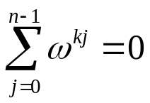
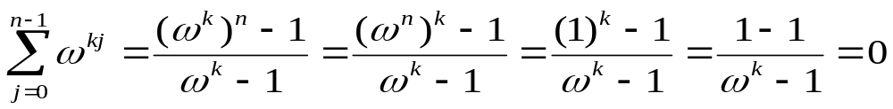
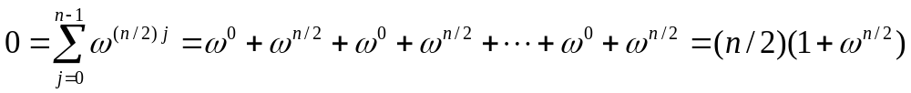
Properties of
Primitive Roots of Unity
Inverse Property: If ω is a primitive root of unity, then ω ⁻¹=ω^{n-1}
  Proof: ωω^{n-1}=ω^{n}=1
Cancellation Property: For non-zero -n<k<n,
  Proof:
Reduction Property: If w is a primitve (2n)-th root of unity, then ω² is a primitive n-th root of unity.
  Proof: If 1,ω,ω²,…,ω^{2n-1} are all distinct, so are 1,ω²,(ω²)²,…,(ω²)^{n-1}
Reflective Property: If n is even, then ω^{n/2} = -1.
  Proof: By the cancellation property, for k=n/2:
  Corollary: ω^{k+n/2}= -ω^{k}.
FFT

Slide 9
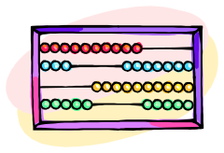
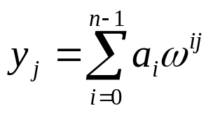
The Discrete Fourier Transform
Given coefficients (a₀,a₁,a₂,…,a_{n-1}) for an (n-1)-degree polynomial p(x)
The Discrete Fourier Transform is to evaluate p at the values
  1,ω,ω²,…,ω^{n-1}
  We produce (y₀,y₁,y₂,…,y_{n-1}), where y_{j}=p(ω^{j})
  That is,
  Matrix form: y=Fa, where F[i,j]=ω^{ij}.
The Inverse Discrete Fourier Transform recovers the coefficients of an (n-1)-degree polynomial given its values at 1,ω,ω²,…,ω^{n-1}
  Matrix form: a=F ⁻¹y, where F ⁻¹[i,j]=ω^{-ij}/n.
FFT

Slide 10

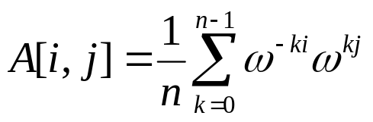
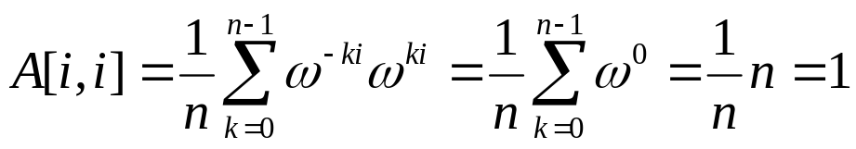
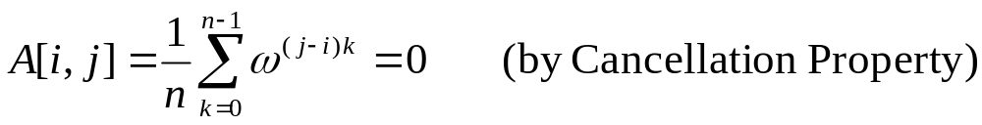
Correctness of the inverse DFT
The DFT and inverse DFT really are inverse operations
Proof: Let A=F ⁻¹F. We want to show that A=I, where
If i=j, then
If i and j are different, then
FFT

Slide 11

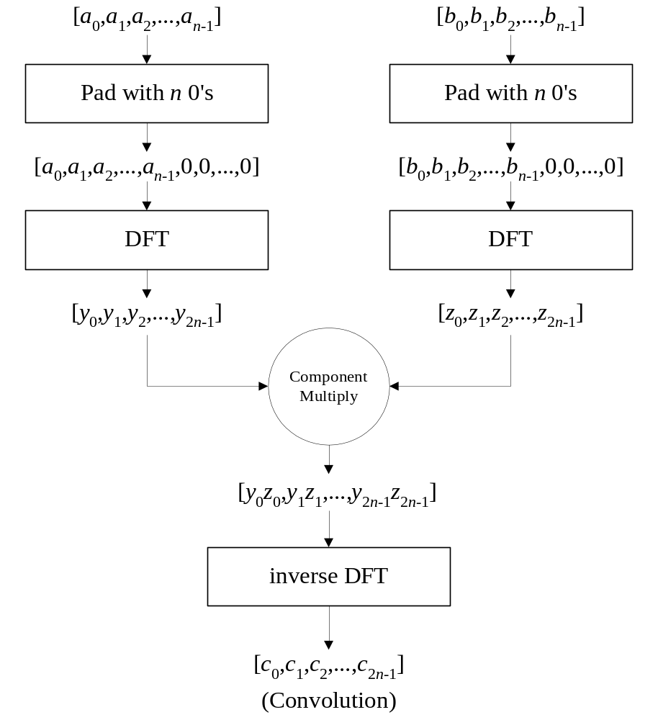
Convolution
The DFT and the inverse DFT can be used to multiply two polynomials
So we can get the coefficients of the product polynomial quickly if we can compute the DFT (and its inverse) quickly…
FFT

Slide 12


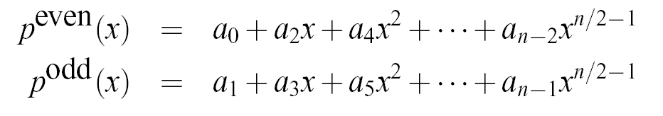

The Fast Fourier Transform
The FFT is an efficient algorithm for computing the DFT
The FFT is based on the divide-and-conquer paradigm:
  If n is even, we can divide a polynomial
  into two polynomials
  and we can write
FFT

Slide 13

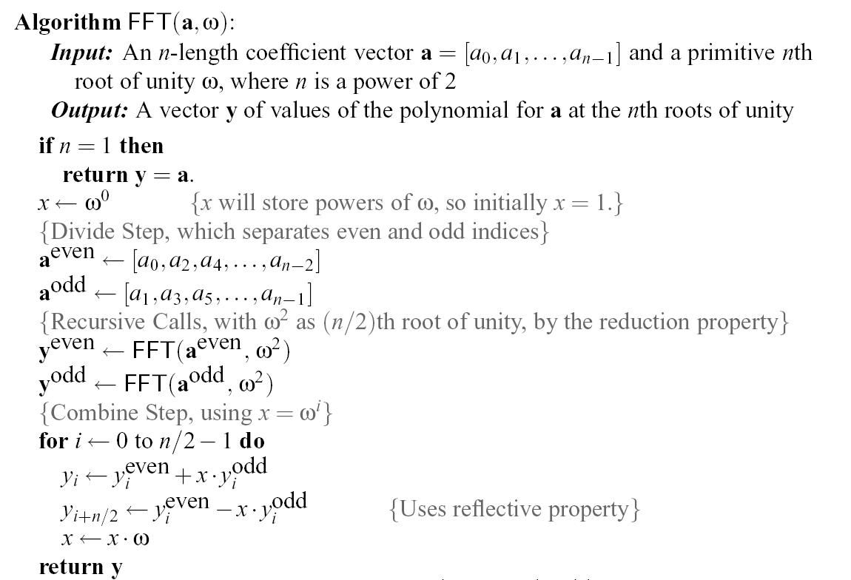
The FFT Algorithm
The running time is O(n log n). [inverse FFT is similar]
FFT

Slide 14

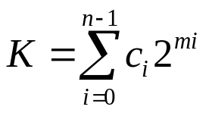
Multiplying Big Integers
Given N-bit integers I and J, compute IJ.
Assume: we can multiply words of O(log N) bits in constant time.
Setup: Find a prime p=cn+1 that can be represented in one word, and set m=(log p)/3, so that we can view I and J as n-length vectors of m-bit words.
Finding a primitive root of unity.
  Find a generator x of Z*_{p}.
  Then ω=x^{c} is a primitive n-th root of unity in Z*_{p} (arithmetic is mod p)
Apply convolution and FFT algorithm to compute the convolution C of the vector representations of I and J.
Then compute
K is a vector representing IJ, and takes O(n log n) time to compute.
FFT

Slide 15

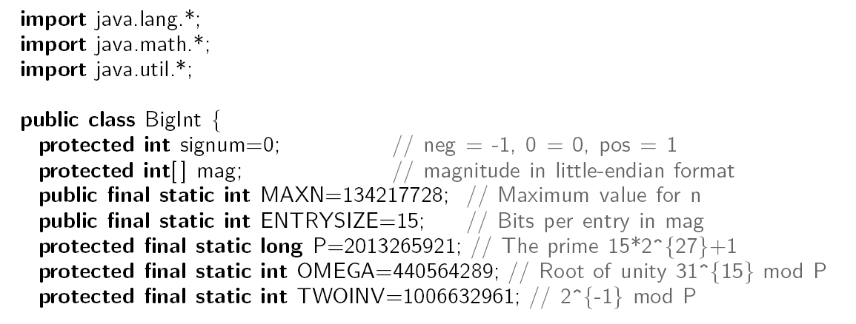
Java Example:
Multiplying Big Integers
Setup: Define BigInt class, and include essential parameters, including the prime, P, and primitive root of unity, OMEGA.
10;
FFT

Slide 16

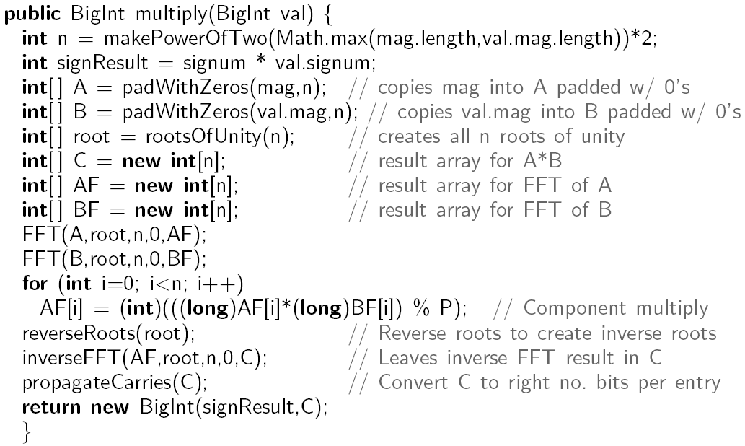
Java Integer Multiply Method
Use convolution to multiply two big integers, this and val:
FFT

Slide 17

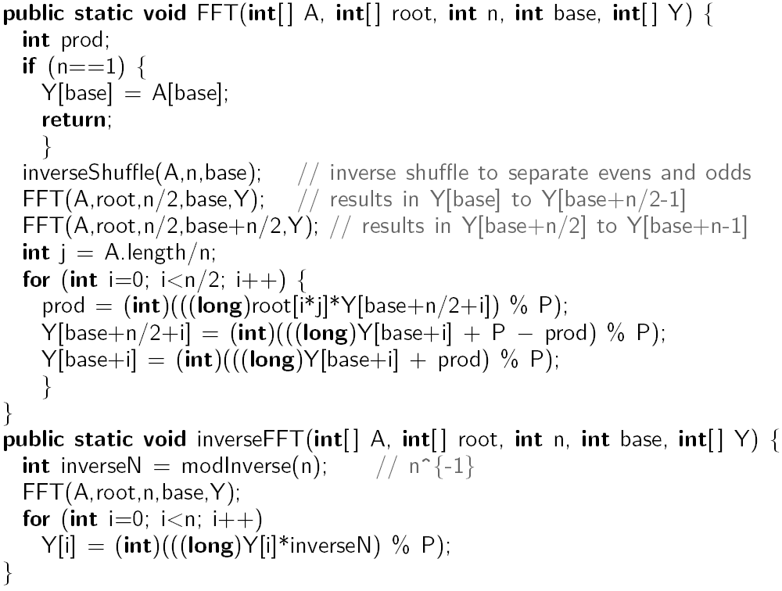
Java FFT in Z*_{p}
FFT

Slide 18

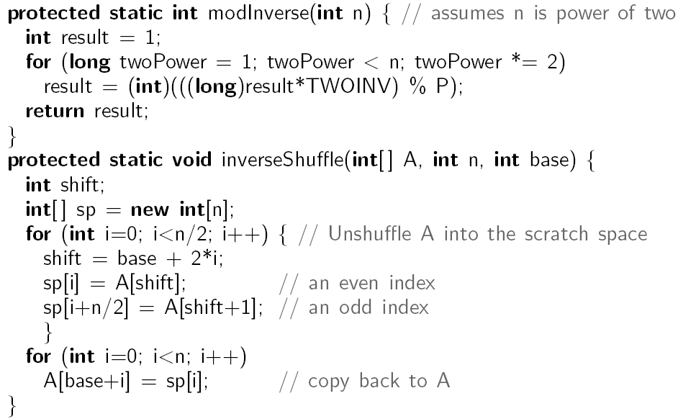
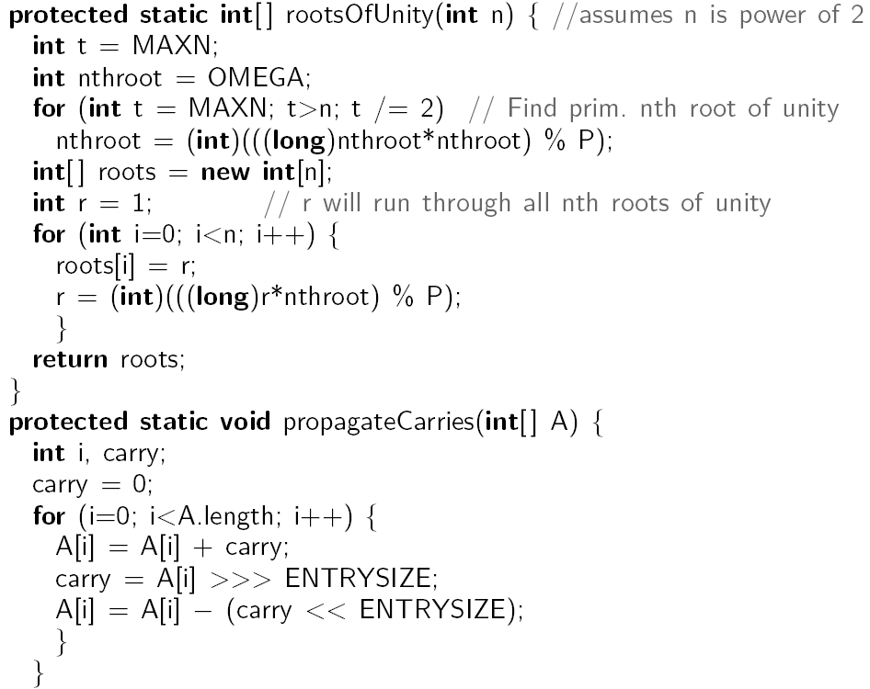
Support Methods for Java FFT in Z*_{p}
FFT

Slide 19

Non-recursive FFT
There is also a non-recursive version of the FFT
  Performs the FFT in place
  Precomputes all roots of unity
  Performs a cumulative collection of shuffles on A and on B prior to the FFT, which amounts to assigning the value at index i to the index bit-reverse(i).
The code is a bit more complex, but the running time is faster by a constant, due to improved overhead
FFT

Slide 20

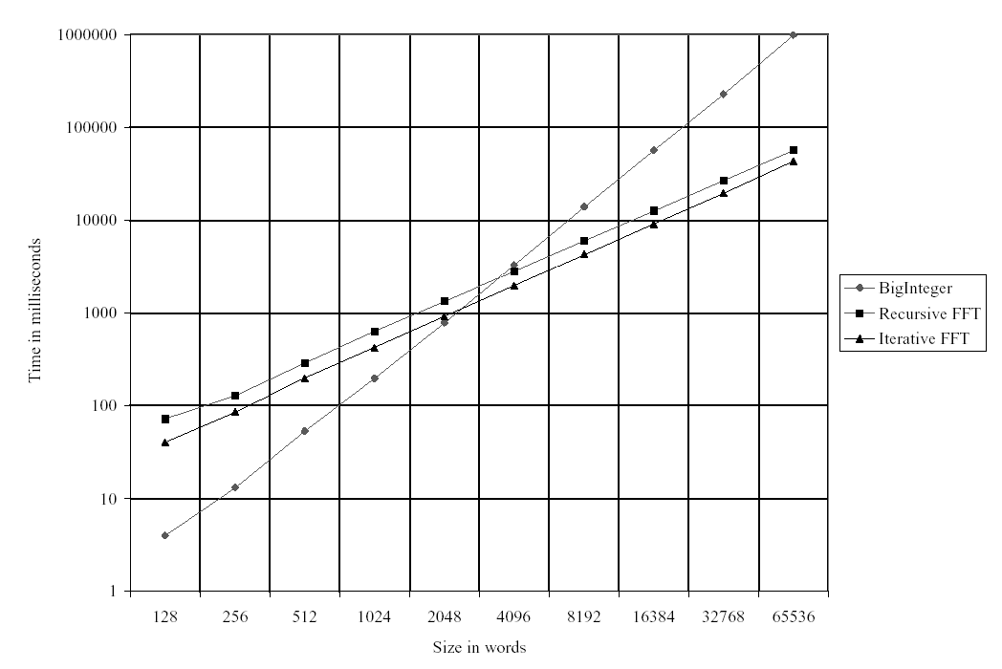
Experimental Results
Log-log scale shows traditional multiply runs in O(n²) time, while FFT versions are almost linear
FFT

